Slide 1
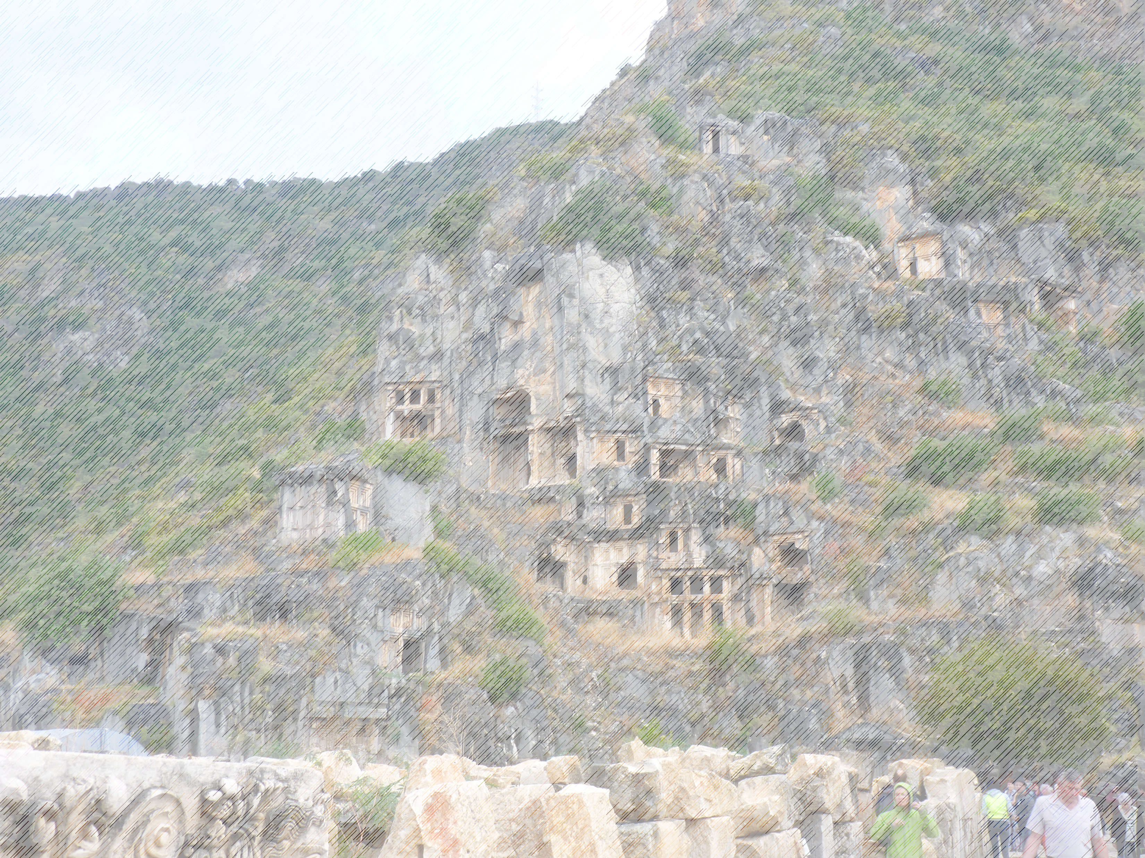
Signs of the Cross
Matthew 27:45-53

Slide 2
Signs of the Cross
Matthew 27:45-53
1. Darkness From the sixth hour until the ninth hour darkness came over all the land. About the ninth hour, Jesus cried out in a loud voice, “Eloi, Eloi, lama sabachthani?” which means “My God, my God, why have you forsaken me?” When some of those standing there heard this, they said, “He’s calling Elijah.” Immediately one of them ran and got a sponge. He filled it with wine-vinegar, put it on a stick, and offered it to Jesus to drink. But the rest said, “Leave him alone! Let’s see if Elijah comes to save him” (vv.45-49).

Slide 3
Signs of the Cross
Matthew 27:45-53
Darkness
Prolonged darkness

Slide 4
Signs of the Cross
Matthew 27:45-53
Darkness
Prolonged darkness
Prolonged silence

Slide 5
Signs of the Cross
Matthew 27:45-53
Darkness
Prolonged darkness
Prolonged silence
Boice: ‘During those hours, the Son of God took the burden of our sins on himself. He was punished for them in our place, and experienced such terrible alienation from his Father that he cried out at the end of that dark period, “Eloi, Eloi, lama sabachthani?” which means, “My God, my God, why have you forsaken me?” (v. 46).’

Slide 6
Signs of the Cross
Matthew 27:45-53
Darkness
2. Torn veil And when Jesus cried out again in a loud voice, he gave his spirit. At that moment the curtain of the temple was torn in two, from top to bottom.

Slide 7
Signs of the Cross
Matthew 27:45-53
Darkness
Torn veil
The curtain

Slide 8
Signs of the Cross
Matthew 27:45-53
Darkness
Torn veil
The curtain
Torn from top to bottom

Slide 9
Signs of the Cross
Matthew 27:45-53
Darkness
Torn veil
3. Earthquake: The tombs broke open and the bodies of many holy people who had died were raised to life. They came out of the tombs, and after Jesus’ resurrection, they went into the holy city, and appeared to many people. (vv:51-53).

Slide 10
Signs of the Cross
Matthew 27:45-53
Darkness
Torn veil
Earthquake
Response: When the centurion and those with him who were guarding Jesus saw the earthquake and all that had happened, they were terrified and exclaimed, “Surely he was the Son of God!”

Slide 11
Signs of the Cross
Matthew 27:45-53
Darkness
Torn veil
Earthquake
Response
Alternative response – the Pharisees and Sadducees

Slide 12
Signs of the Cross
Matthew 27:45-53
Darkness
Torn veil
Earthquake
Response
Alternative response – the Pharisees and Sadducees
Choices – resist the message like Pharisees and Sadducees

Slide 13
Signs of the Cross
Matthew 27:45-53
Darkness
Torn veil
Earthquake
Response
Alternative response – the Pharisees and Sadducees
Choices – resist the message like Pharisees and Sadducees
- accept the message like Roman centurion

Slide 14
Signs of the Cross
Matthew 27:45-53
Darkness
Torn veil
Earthquake
Response
Alternative response – the Pharisees and Sadducees
Choices – resist the message like Pharisees and Sadducees
- accept the message like Roman centurion
Sin = offensive to God, must be punished

Slide 15
Signs of the Cross
Matthew 27:45-53
Darkness
Torn veil
Earthquake
Response
Alternative response – the Pharisees and Sadducees
Choices – resist the message like Pharisees and Sadducees
- accept the message like Roman centurion
Sin = offensive to God, must be punished
Jesus = our sin sacrifice – God’s punishment fell on him

Slide 16
Signs of the Cross
Matthew 27:45-53
Darkness
Torn veil
Earthquake
Response
Alternative response – the Pharisees and Sadducees
Choices – resist the message like Pharisees and Sadducees
- accept the message like Roman centurion
Sin = offensive to God, must be punished
Jesus = our sin sacrifice – God’s punishment fell on him
Because of him, we can move from darkness to light

Slide 17
Signs of the Cross
Matthew 27:45-53
Darkness
Torn veil
Earthquake
Response
Alternative response – the Pharisees and Sadducees
Choices – resist the message like Pharisees and Sadducees
- accept the message like Roman centurion
Sin = offensive to God, must be punished
Jesus = our sin sacrifice – God’s punishment fell on him
Because of him, we can move from darkness to light
He guarantees life after death

Slide 18
Signs of the Cross
Matthew 27:45-53
Darkness
Torn veil
Earthquake
Meaning of Good Friday?

Slide 19
Signs of the Cross
Matthew 27:45-53
Darkness
Torn veil
Earthquake
Meaning of Good Friday?
Forgiveness

Slide 20
Signs of the Cross
Matthew 27:45-53
Darkness
Torn veil
Earthquake
Meaning of Good Friday?
Forgiveness
Purpose

Slide 21
Signs of the Cross
Matthew 27:45-53
Darkness
Torn veil
Earthquake
Meaning of Good Friday?
Forgiveness
Purpose
Deliverance

Slide 22
Signs of the Cross
Matthew 27:45-53
Darkness
Torn veil
Earthquake
Meaning of Good Friday?
Forgiveness
Purpose
Deliverance
What is our response?

